Slide 1
Basic Computing Curriculum
Session 8: Introduction to Networks and Network Cable Assembly
Notes:
This presentation will introduce you to the basic concepts of computer networking and teach you how to assemble network cables. We will begin by exploring the importance of networking in computing and the different types of networks. Then, we will delve into the components of a network and how to connect to a network. Finally, we will learn the basic concepts of network configuration and cable assembly.

Slide 2
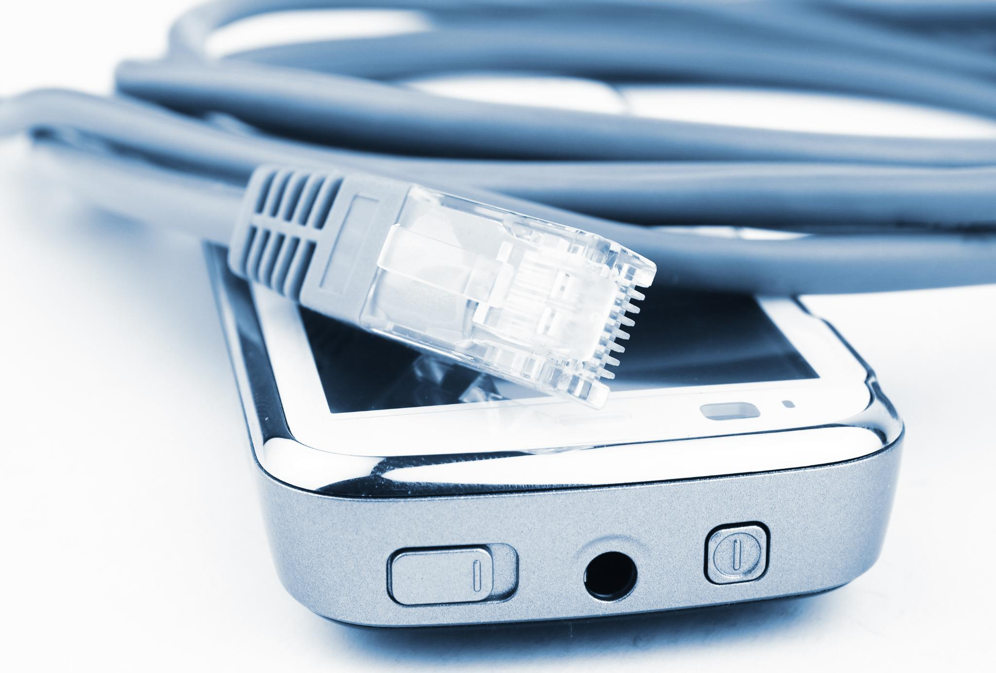
Session Overview
Basic Networking Concepts
  This session will cover basic networking concepts and their importance in modern computing, including different types of networks and network components.
Wired and Wi-Fi Connections
  Participants will learn about wired and Wi-Fi connections, how they differ from each other, and their advantages and disadvantages.
Network Configuration
  This session will cover basic concepts of network configuration, including IP addressing, subnetting, and DNS settings.
Network Cable Assembly
  Participants will learn how to assemble network cables, including different types of cables, connectors, and wiring standards.
Notes:
The objective of this session is to understand basic networking concepts, their importance in computing, and learn how to assemble network cables. We will cover the different types of networks, network components, wired and Wi-Fi connections, basic concepts of network configuration, and network cable assembly.

Slide 3
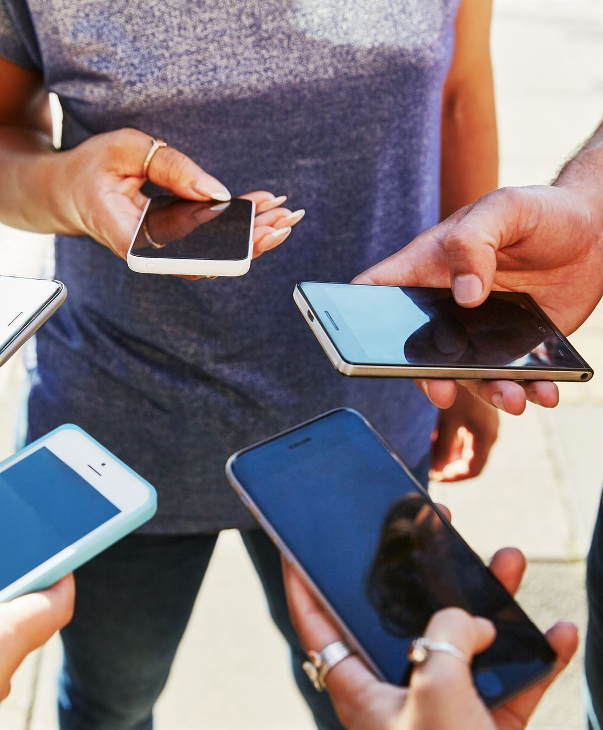
Introduction to Computer Networking
What is Computer Networking?
  A computer network is a group of devices, including computers, printers and servers that are connected together to share resources and communicate with each other.
Types of Computer Networks
  There are several types of computer networks including LAN, WAN, and MAN. These networks have different sizes and are used for different purposes.
Importance of Computer Networking
  Computer networking has revolutionized the way we work and communicate. It allows people to access information and resources from anywhere in the world and has made it possible to collaborate on projects with people in different locations.
Notes:
A computer network is a group of devices that are connected together to share resources and communicate with each other. In this section, we will explore the importance of networking in computing and the different types of networks.

Slide 4

What is a Computer Network?
Definition of Computer Network
  A computer network is a group of interconnected devices that can communicate with each other and share resources, such as files, printers, and internet access.
Classification by Size
  Computer networks can be classified by their size, such as LAN (Local Area Network), MAN (Metropolitan Area Network), and WAN (Wide Area Network).
Classification by Scope
  Computer networks can also be classified by their scope, such as Peer-to-Peer Network, Client-Server Network, and Cloud Network.
Notes:
A computer network is a group of devices that are connected together to share resources and communicate with each other. Networks can be classified by their size, scope, and purpose.

Slide 5
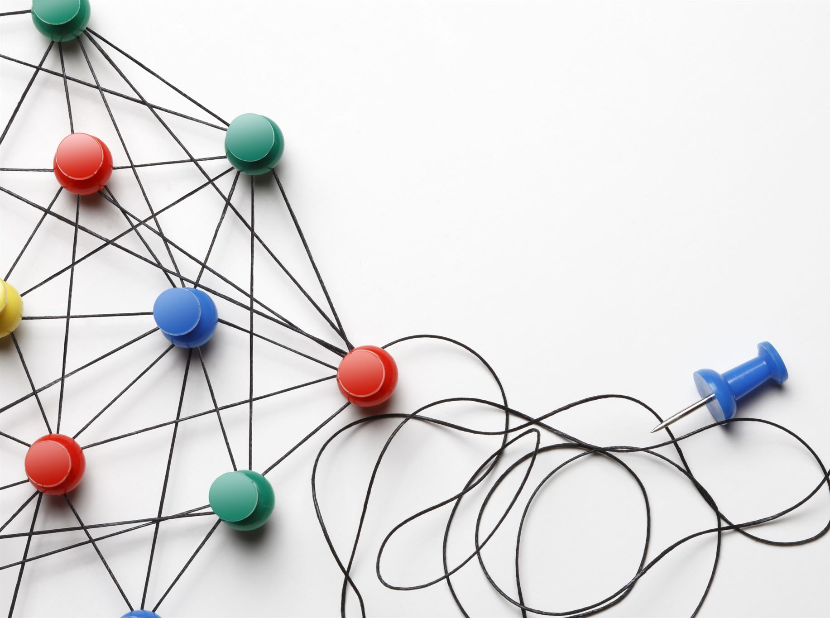
Types of Networks
Local Area Network (LAN)
  A LAN is a network of computers and devices located in a small geographic area, such as an office or building. It is commonly used to share resources and connect devices within a small area.
Wide Area Network (WAN)
  A WAN is a network that spans a large geographical area, such as a city or country. It is commonly used to connect LANs and other networks over a long distance.
Personal Area Network (PAN)
  A PAN is a network of devices located in a small area, such as a person's workspace or home. It is commonly used to connect personal devices, such as a laptop to a phone or a wearable device.
Metropolitan Area Network (MAN)
  A MAN is a network that spans a metropolitan area, such as a city or town. It is commonly used to connect LANs and other networks within a city, such as a campus or a business district.
Notes:
There are different types of networks, including LAN, WAN, PAN, and MAN. Each has its own characteristics and purpose.

Slide 6
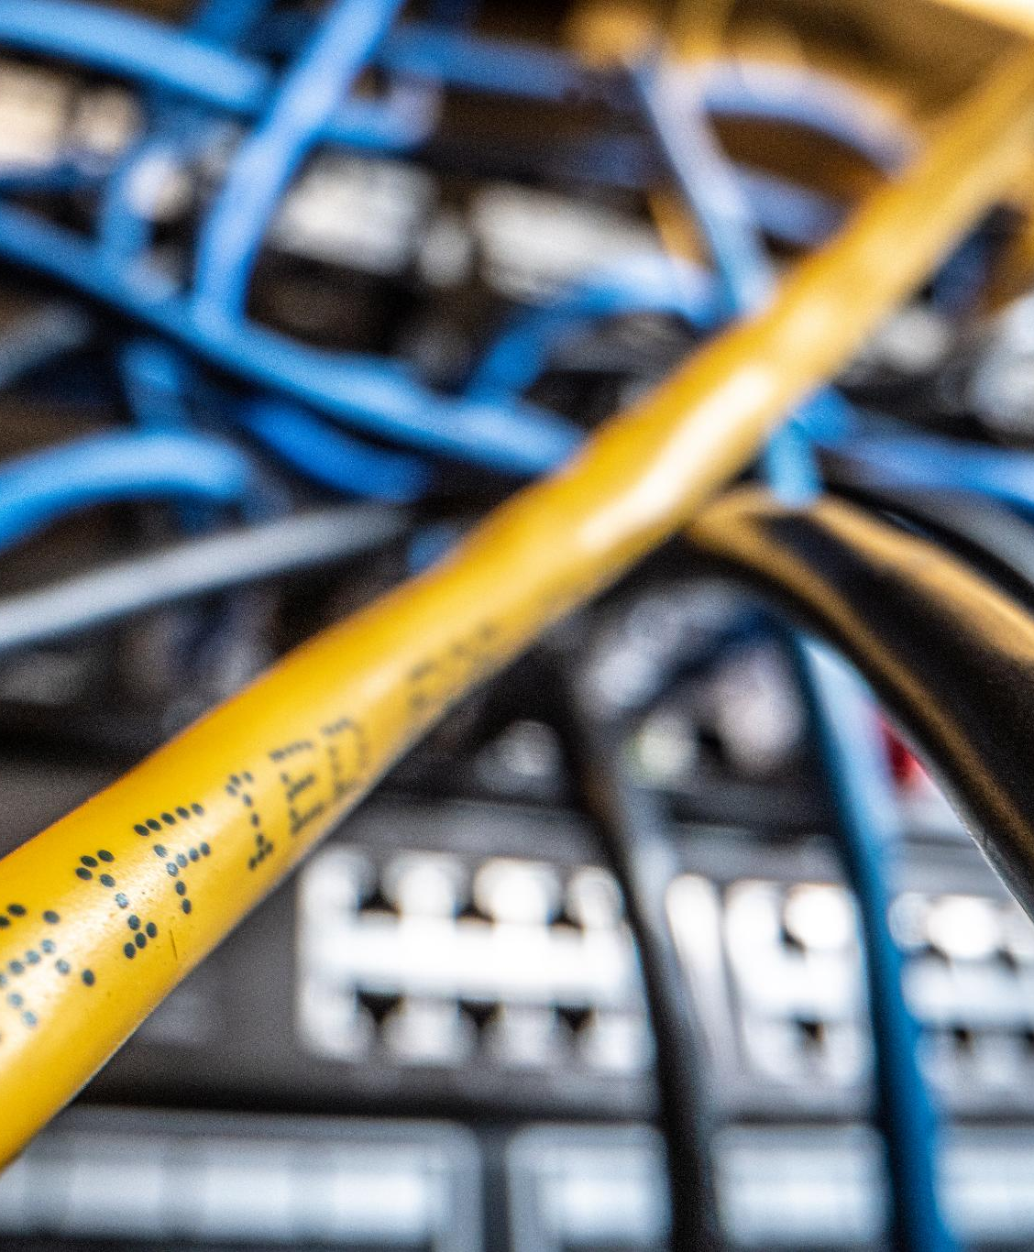
Network Components
Switches
  Switches are network devices that connect multiple devices together on a LAN and allow them to communicate with each other. They operate at the data link layer of the OSI model and use MAC addresses to forward data.
Routers
  Routers are network devices that connect multiple networks together and enable communication between devices on different networks. They operate at the network layer of the OSI model and use IP addresses to forward data.
Hubs
  Hubs are network devices that connect multiple devices together on a LAN and allow them to communicate with each other. They operate at the physical layer of the OSI model and transmit data to all connected devices, regardless of the recipient.
Notes:
A network is made up of various components, such as switches, routers, hubs, and cables. In this section, we will explore the function of each component and how they work together to form a network.

Slide 7
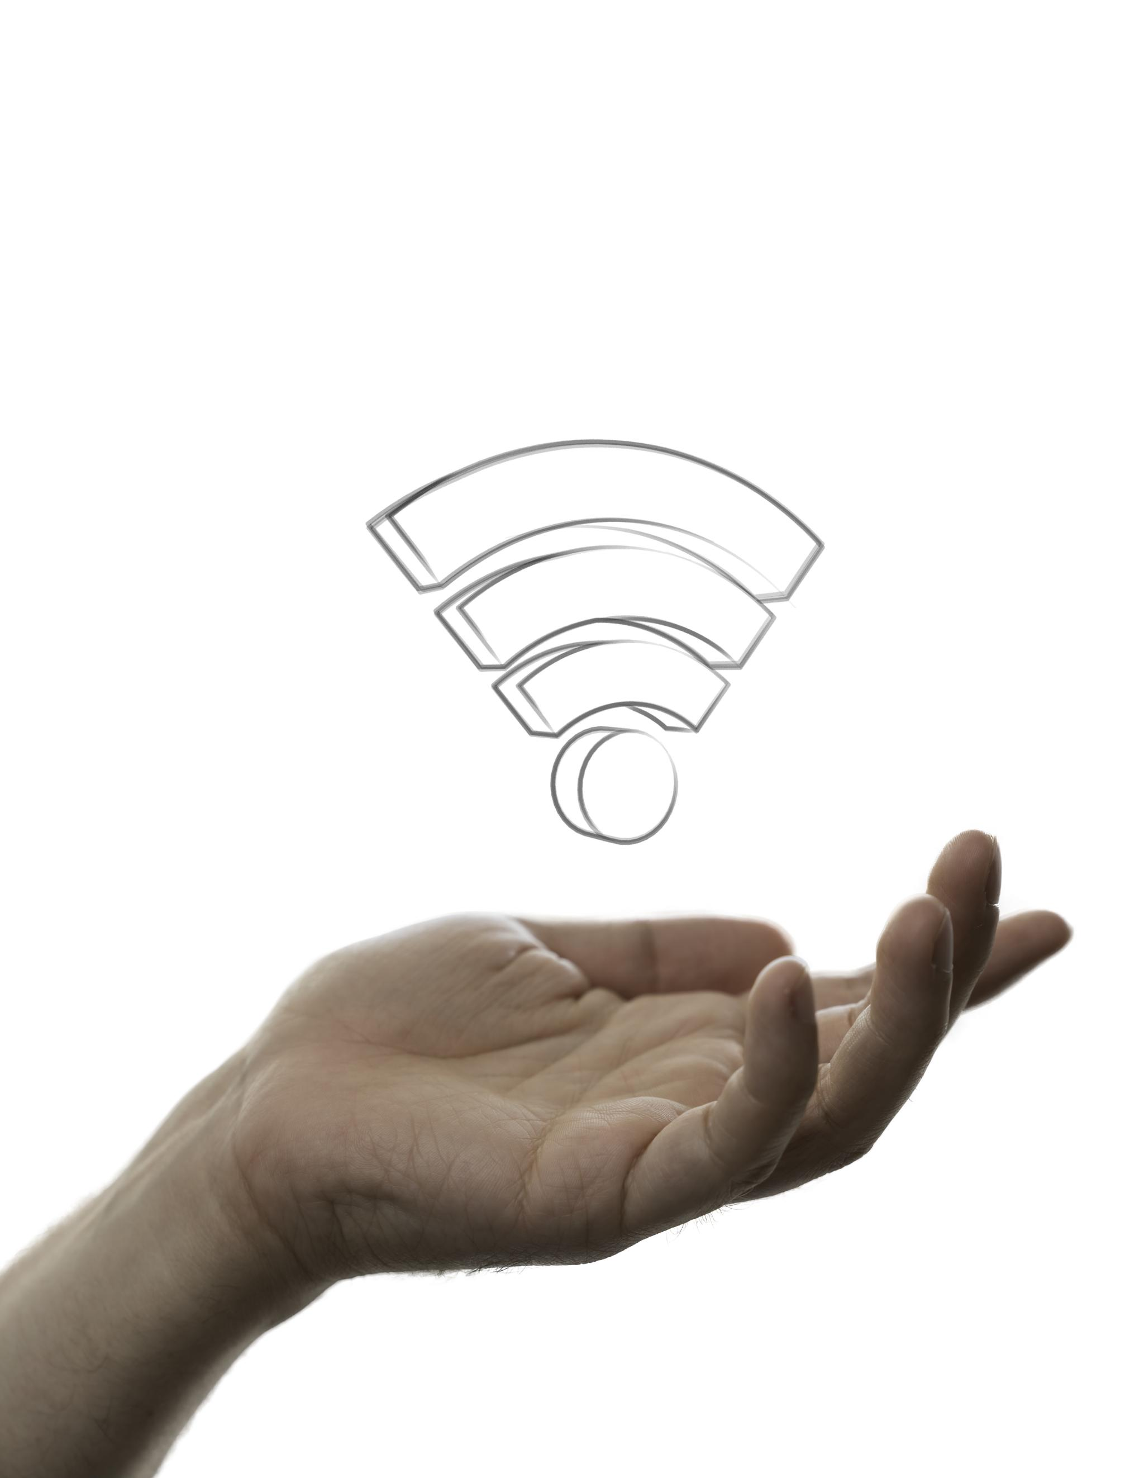
Connecting to a Network: Wired and Wi-Fi
Wired Connections
  Wired connections use cables to connect a device to the network. They are faster, more reliable, and more secure than Wi-Fi connections. They are ideal for devices that require a lot of bandwidth, like desktop computers and gaming consoles.
Wi-Fi Connections
  Wi-Fi connections use radio waves to connect a device to the network. They are more convenient than wired connections since they don't require cables, but they are slower, less reliable, and less secure. Wi-Fi is ideal for mobile devices like smartphones and tablets.
Notes:
There are two primary ways to connect to a network: wired and Wi-Fi. In this section, we will explore the differences between the two and when to use each.

Slide 8
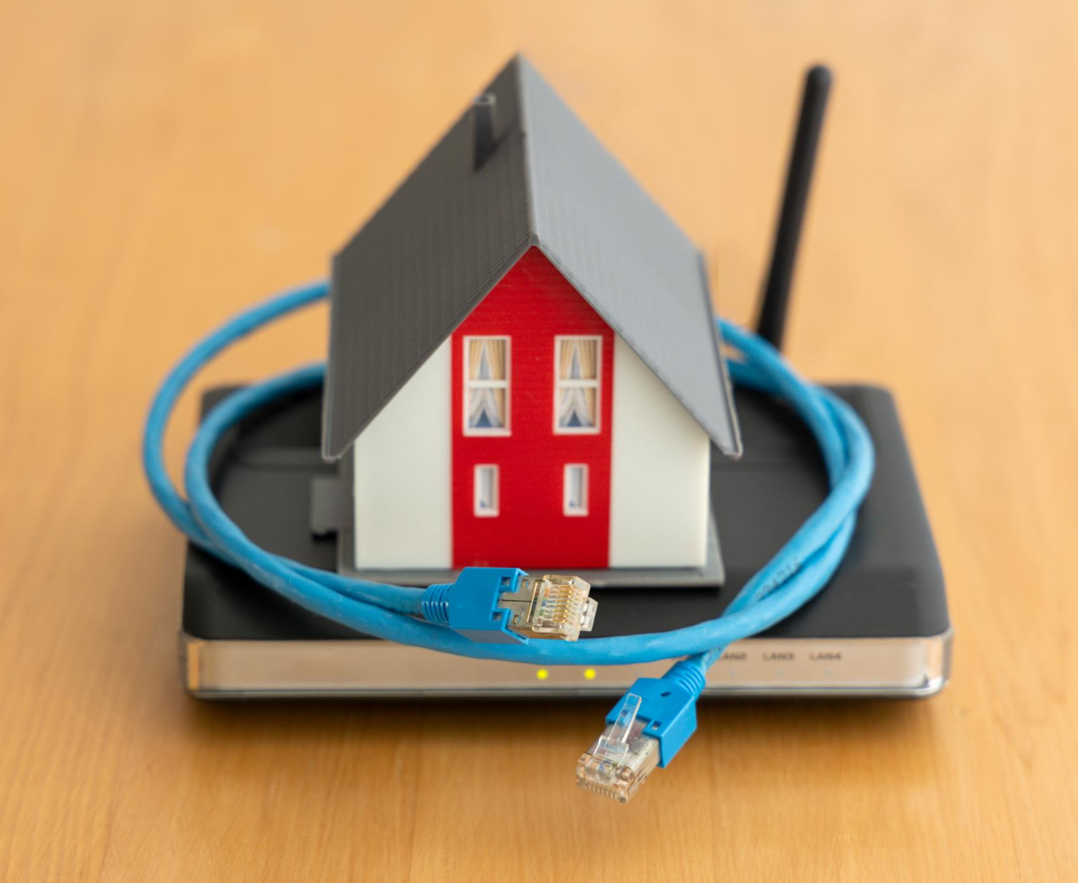
Wired Connection
Reliable and Secure
  Wired connections are generally more reliable and secure than wireless connections, as there is less interference and the signal is less likely to be hacked or intercepted.
Difficult to Set Up
  Wired connections can be more difficult to set up than wireless connections, as they require physical cables and may require drilling or other modifications to the building.
Notes:
A wired connection uses physical cables to connect to a network. This is a reliable and secure way to connect, but it can also be more difficult to set up.

Slide 9
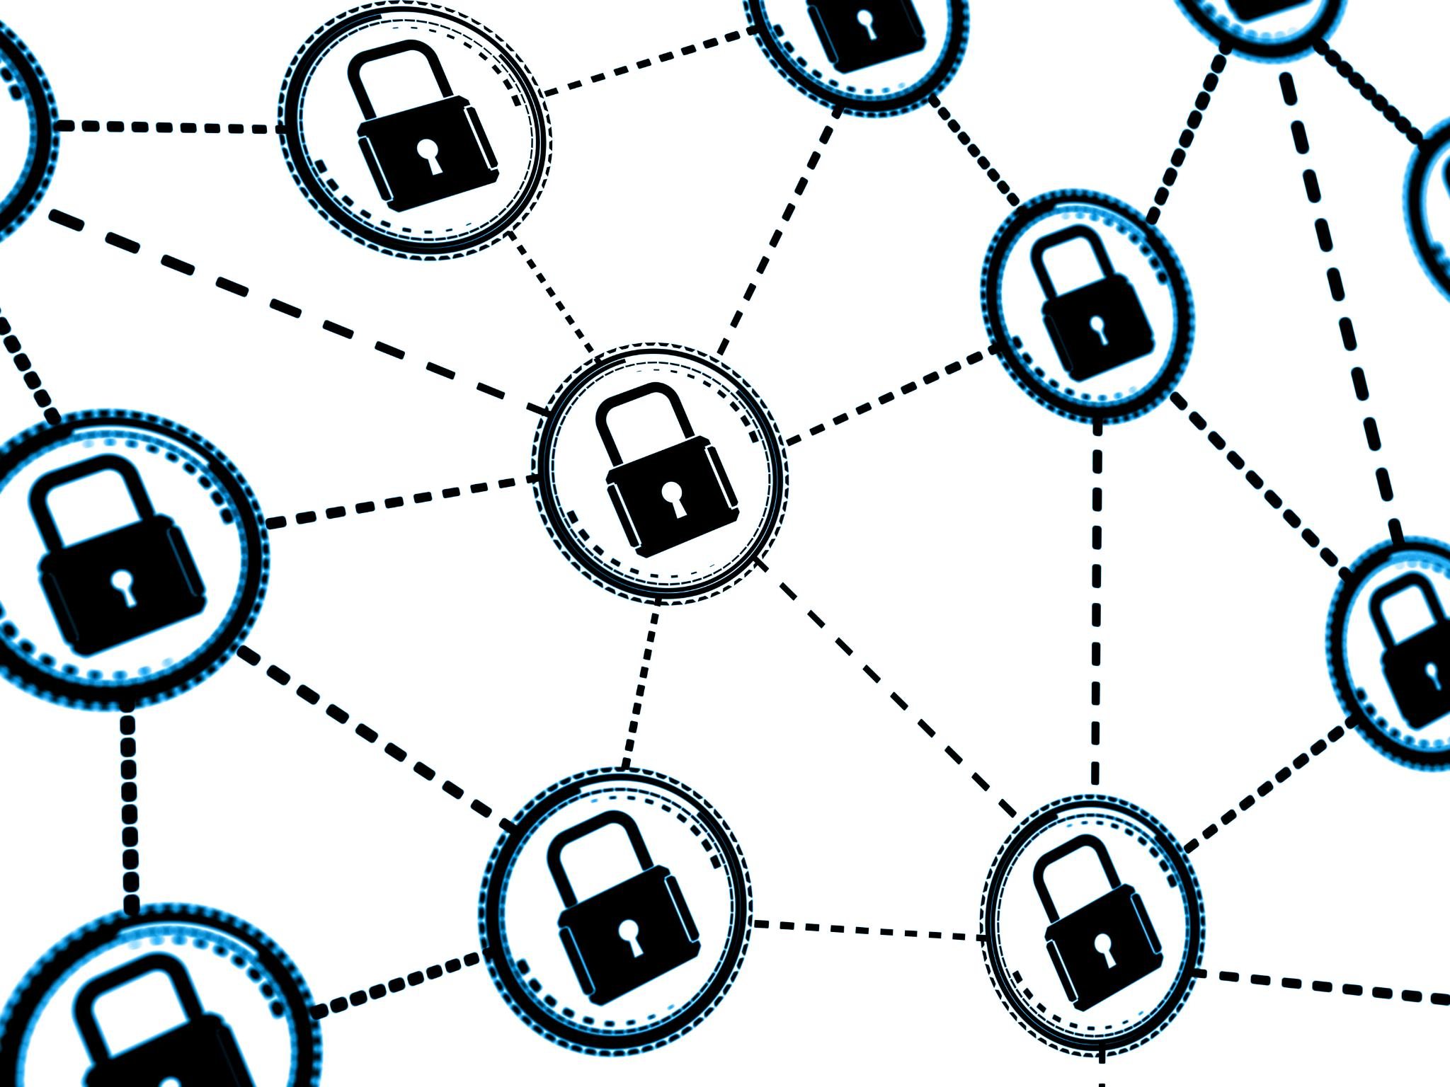
Wi-Fi Connection
Wireless Connectivity
  A Wi-Fi connection uses wireless signals to connect to a network, providing a convenient and easy way to connect to the internet or other devices.
Security
  While Wi-Fi is a convenient connection method, it may not be as secure or reliable as a wired connection. Users should take steps to secure their wireless connections, such as using strong passwords and encryption.
Notes:
A Wi-Fi connection uses wireless signals to connect to a network. This is a convenient and easy way to connect, but it may not be as secure or reliable as a wired connection.

Slide 10
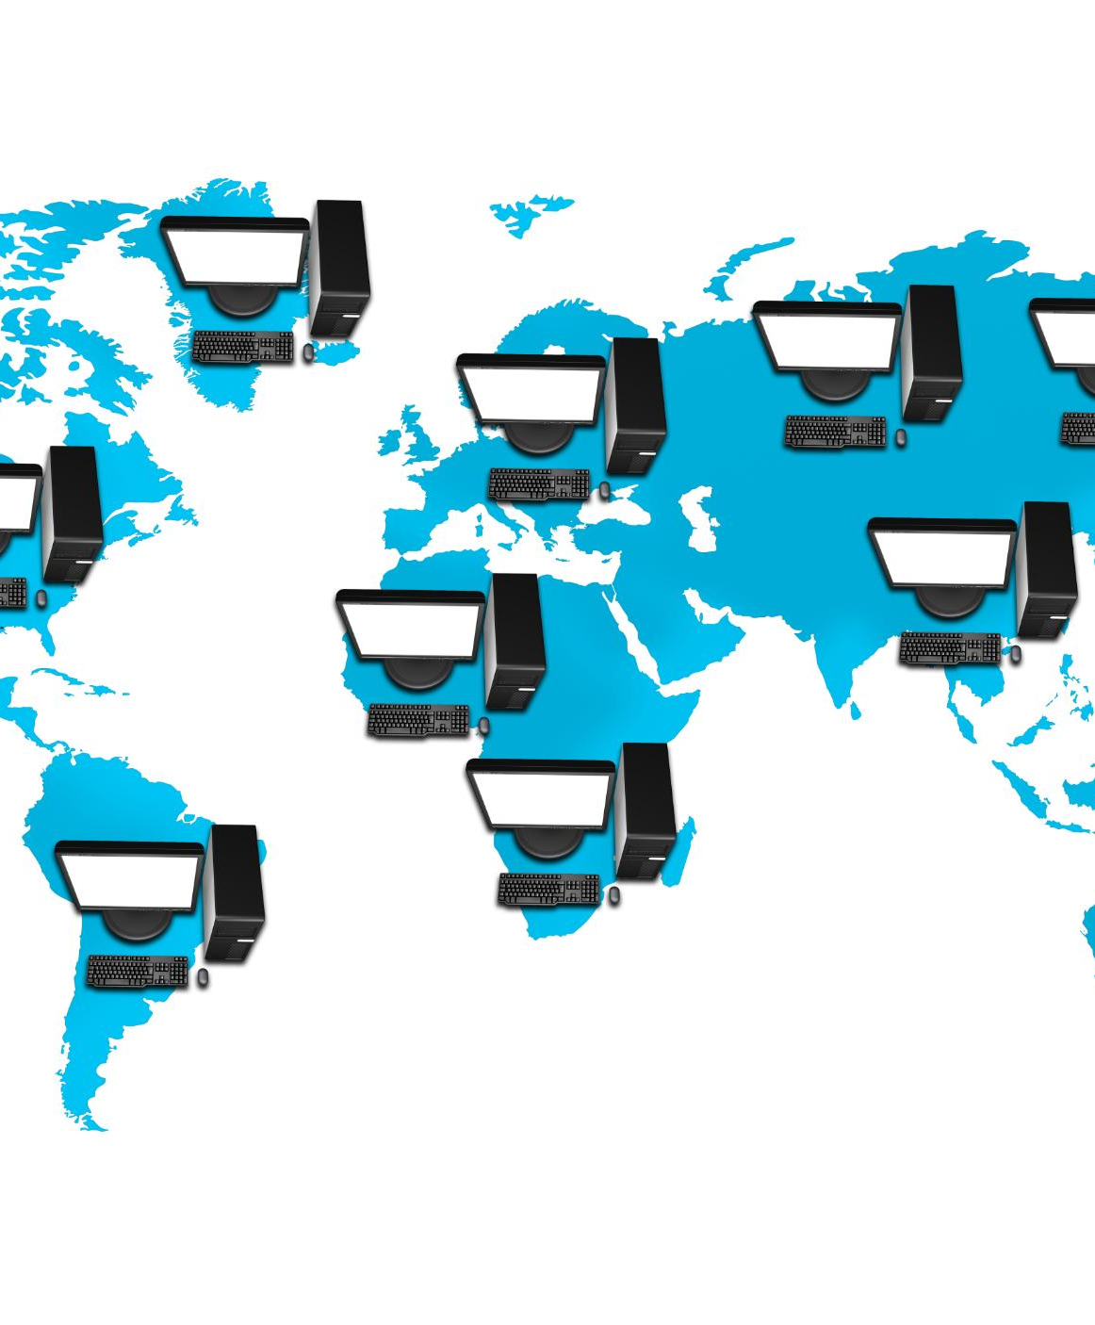
Basic Concepts of Network Configuration
IP Addresses
  An IP address is a unique identifier assigned to each device on a network. It is used to route data between devices and networks.
Subnet Masks
  A subnet mask is a number that determines which part of an IP address represents the network and which part represents the device. It is used to divide a network into smaller subnets for better organization and security.
Gateways
  A gateway is a device that connects two or more networks together and routes data between them. It is used to enable communication between devices on different networks.
Notes:
Network configuration involves setting up the devices on a network to communicate with each other. In this section, we will explore the basic concepts of network configuration, including IP addresses, subnet masks, and gateways.

Slide 11

IP Addresses
  An IP address is a unique identifier that is assigned to each device on a network. It is used to route data between devices and can be either static or dynamic depending on the network configuration.
Notes:
An IP address is a unique identifier that is assigned to each device on a network. IP addresses can be static or dynamic, and they are used to route data between devices.

Slide 12

Subnet Masks
  A subnet mask is used in the process of subnetting, which involves dividing a larger network into smaller subnetworks. Subnetting allows for more efficient use of IP addresses and can improve network performance and security.
Notes:
A subnet mask is used to divide a network into smaller subnetworks. It is used in conjunction with an IP address to determine the network and host portions of an address.

Slide 13
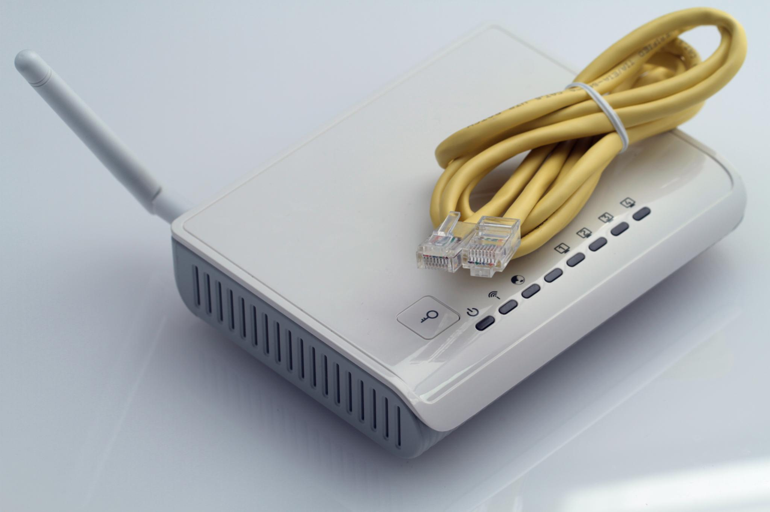
Gateways
  A gateway is a device that connects two different networks together, enabling communication between them. It acts as a bridge between two networks and is used to route data between them.
Notes:
A gateway is a device that connects two different networks together. It is used to route data between networks.

Slide 14
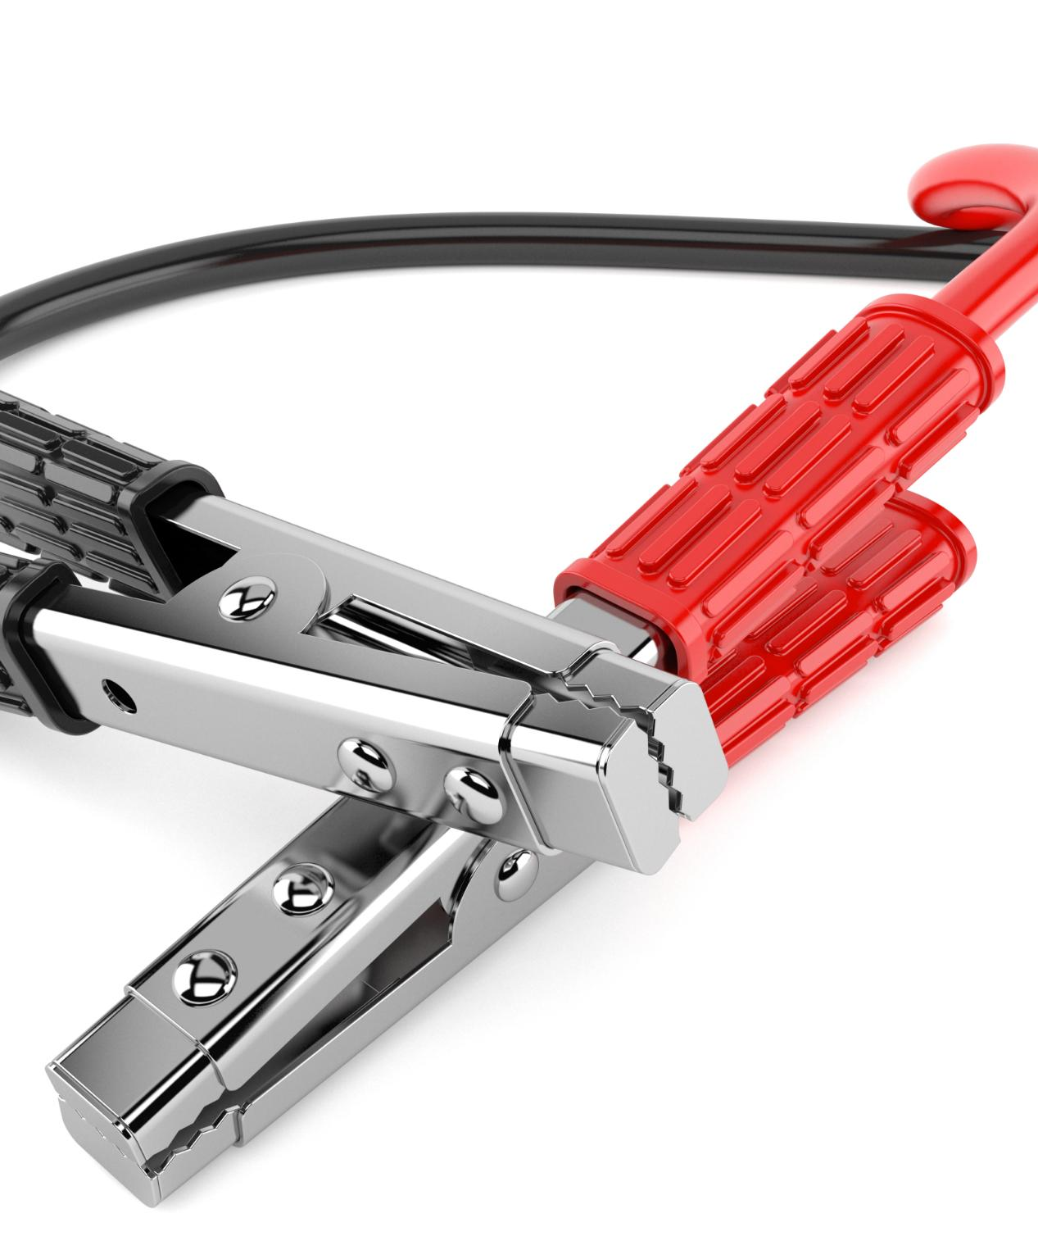
Network Cable Assembly
Tools Required
  To assemble network cables, you will need several tools, including a cable cutter, a cable stripper, and a crimping tool. These tools will help you prepare the cable and attach the connectors with ease.
Preparing the Cable
  Before you attach the connectors, you need to strip the cable to expose the wires. Carefully remove the outer layer of the cable and separate the wires according to the wiring scheme you are using.
Attaching Connectors
  Once the cable is prepared, you can attach the connectors using a crimping tool. Make sure you follow the correct wiring scheme for the connector you are using to ensure a proper connection.
Notes:
Assembling network cables is a simple yet essential skill for anyone working with computer networks. In this section, we will learn how to assemble network cables and crimp connectors onto the ends.

Slide 15
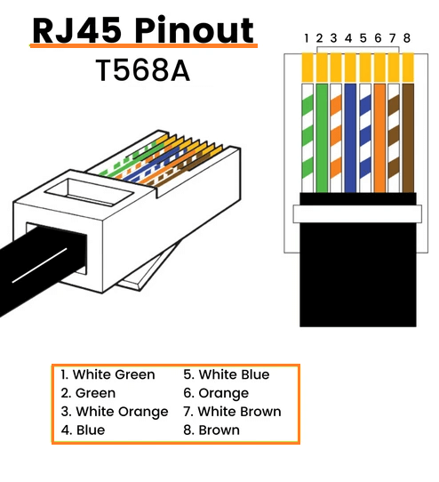
Network Cable Assembly
Tools Needed
  To assemble a network cable, you will need a cable, connectors, and a crimping tool.
Stripping the Cable
  The first step in assembling a network cable is to strip the cable. This is done by removing the protective cover from the end of the cable, exposing the wires inside.
Inserting the Connector
  The next step is to insert the connector onto the stripped end of the cable. This is done by carefully aligning the wires with the pins inside the connector and pushing the connector onto the cable.
Crimping the Connector
  The final step is to crimp the connector onto the cable. This is done by using a crimping tool to press down on the pins inside the connector, securing the wires in place.
Notes:
To assemble a network cable, you will need a cable, connectors, and a crimping tool. We will go through the steps of stripping the cable, inserting the connector, and crimping it onto the cable.

Slide 16
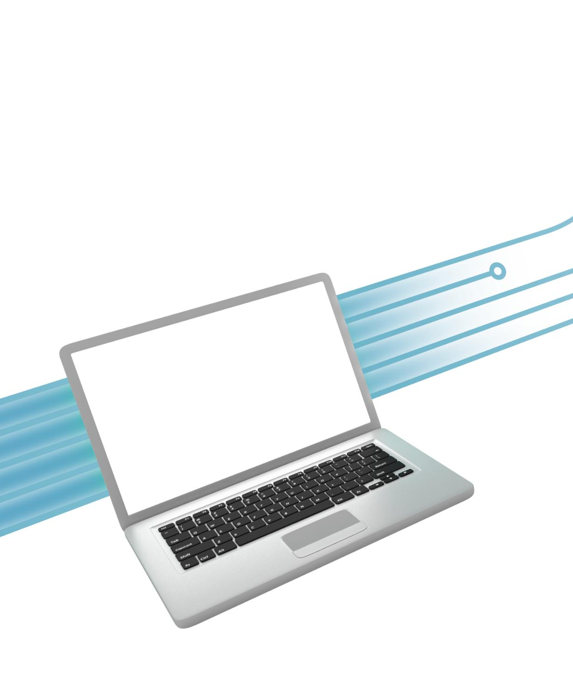
Practical Activity
Connecting to Wi-Fi
  In this practical activity, we will connect a computer to a Wi-Fi network and verify the connection, which is an important skill in today's connected world.
Performing a Ping Test
  We will also perform a ping test to verify the connection and troubleshoot any issues that may arise, which is a fundamental skill for any network technician.
Assembling and Crimping a Network Cable
  Finally, we will assemble and crimp a network cable, a necessary task for anyone involved in network installation or maintenance.
Notes:
In this practical activity, we will connect a computer to a Wi-Fi network, verify the connection, and perform a ping test. We will also assemble and crimp a network cable.

Slide 17
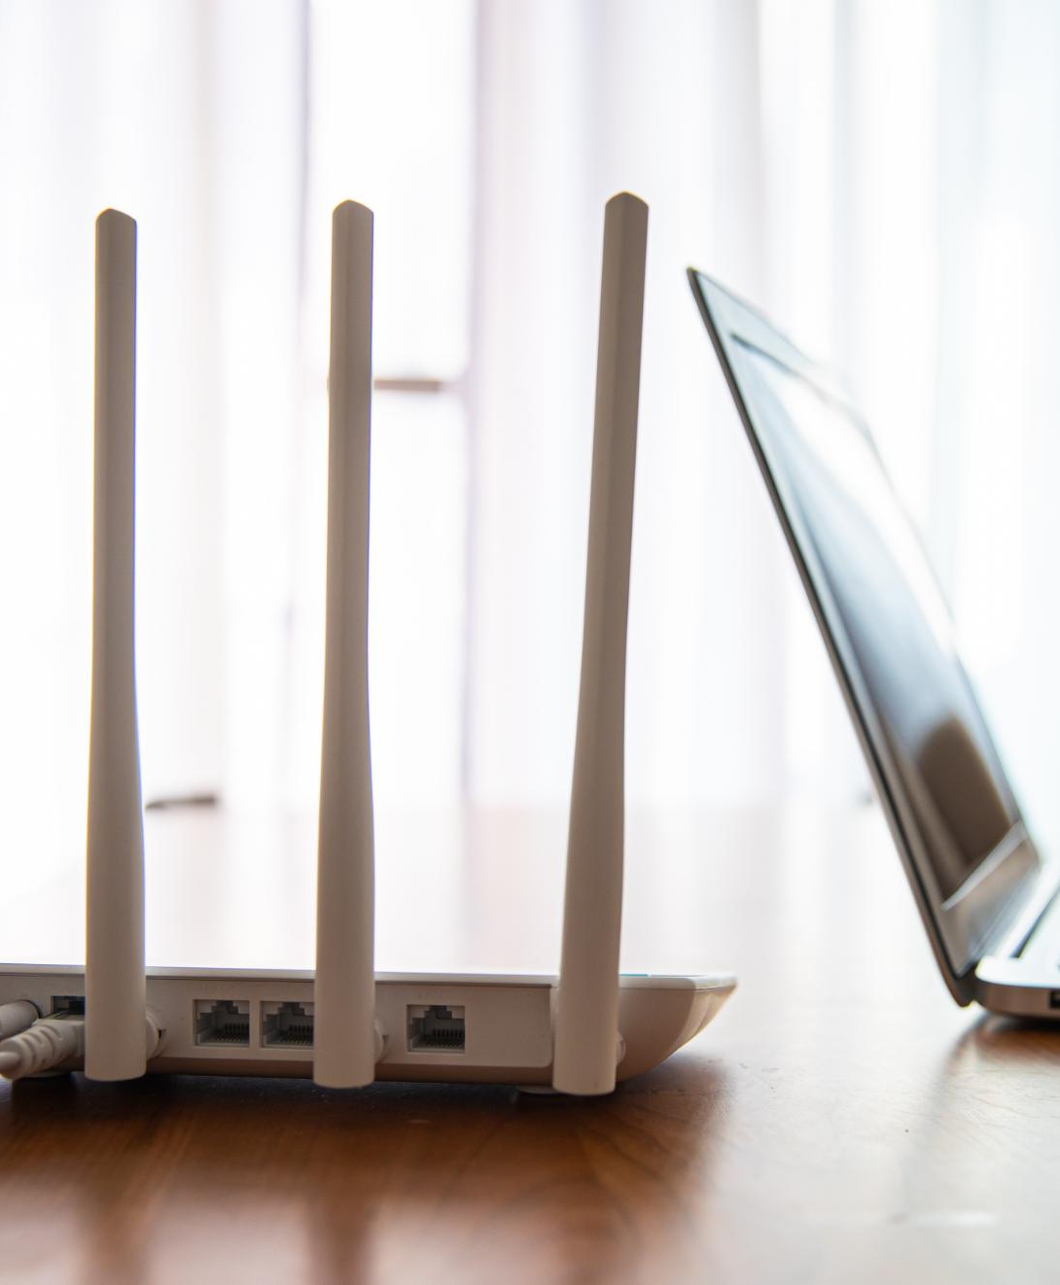
Connect to a Wi-Fi Network
Locate the Network
  To connect to a Wi-Fi network, you will need to locate the network by selecting it from the list of available networks.
Enter the Password
  Once you have located the network, you will need to enter the password to connect to it.
Verify the Connection
  After connecting to the Wi-Fi network, we will verify the connection by checking the signal strength and speed.
Notes:
To connect to a Wi-Fi network, you will need to locate the network, enter the password, and wait for the connection to establish. Once connected, we will verify the connection and perform a ping test.

Slide 18

Assemble and Crimp a Network Cable
  To assemble a network cable, we will need to strip the cable, insert the connector, and crimp it onto the cable. These steps will ensure that the cable is properly assembled and ready for use.
Notes:
To assemble and crimp a network cable, we will follow the steps outlined in the previous section. We will strip the cable, insert the connector, and crimp it onto the cable.

Slide 19
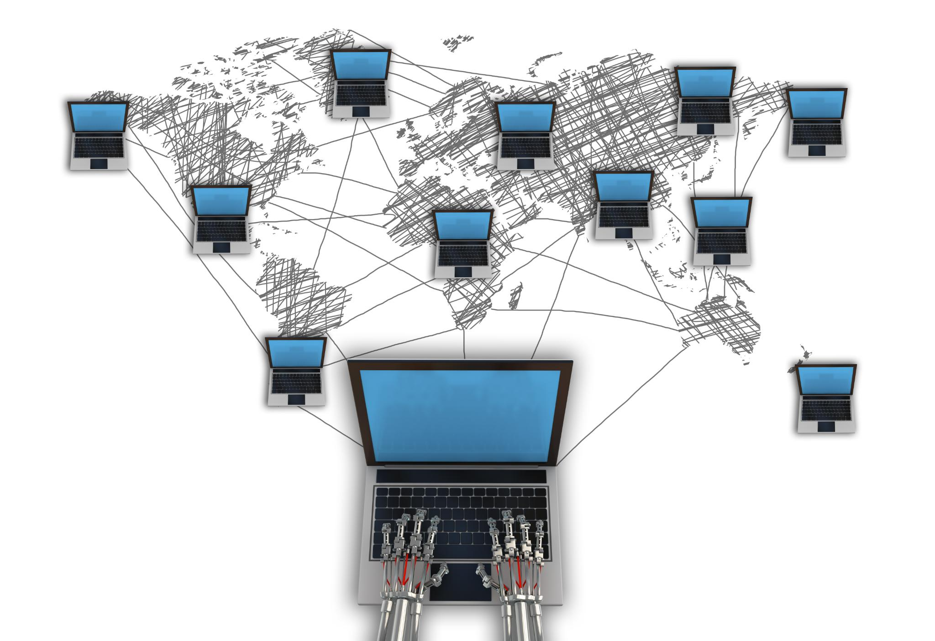
Summary
  In this session, we learned about the basic concepts of computer networking, different types of networks, network components, wired and Wi-Fi connections, network configuration, and network cable assembly. We also applied our learning through a practical activity.
Notes:
In this session, we learned about the basic concepts of computer networking, the different types of networks, network components, wired and Wi-Fi connections, basic concepts of network configuration, and network cable assembly. We also completed a practical activity to apply what we learned.

